Slide 1

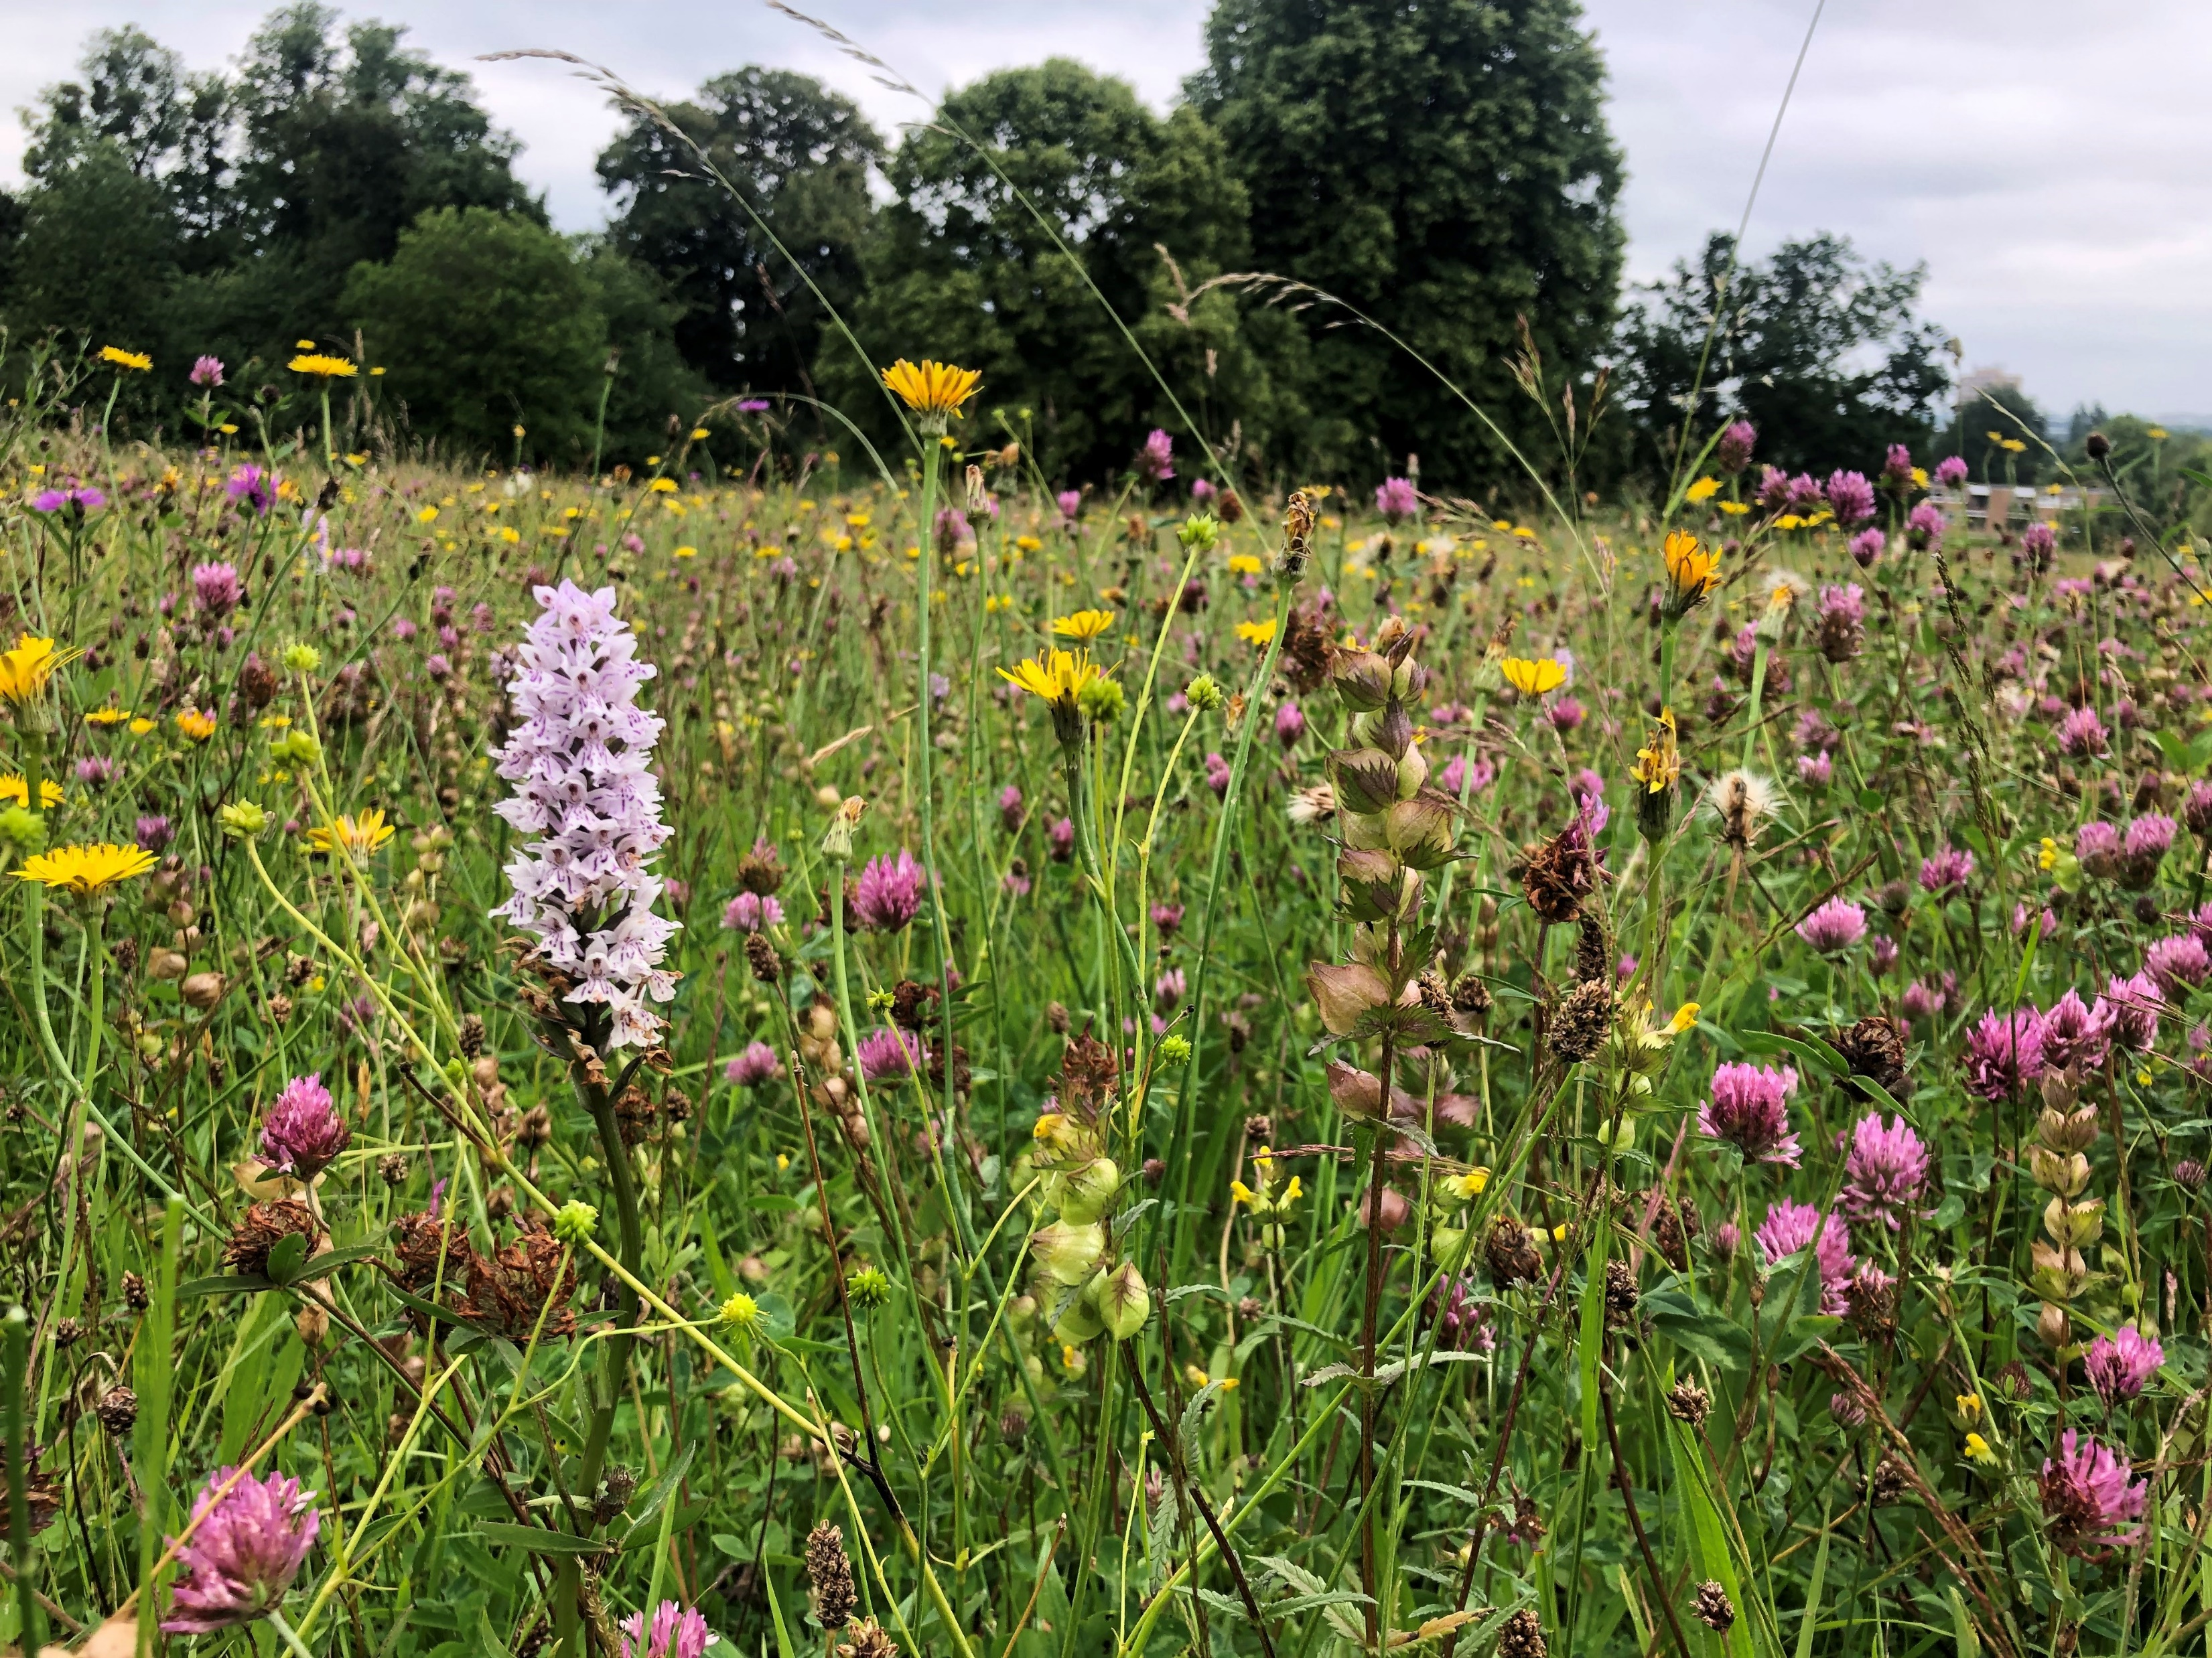
Wildlife corridors and urban nature reserves
Notes:
Hi I’m Esther. I am the Team Wilder Community Ecologist and work as part of Team Wilder. Team Wilder is the movement of people who notice and celebrate nature in their day-to-day lives, where communities and inviduals can get involved in tackling biodiversity loss.
I run the Team Wilder Ecological Advisory Service where I advise individuals and communities on the creation and enhancement of habitats with their community, land or garden. It’s a free service that covers the Avon area.
I’m going to run through community urban nature reserves and wildlife corridors today and show you how Team Wilder can support you in the process of creating a community urban nature reserve.

Slide 2
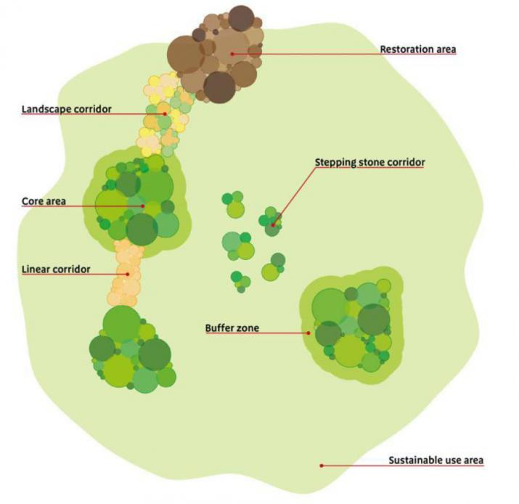
Wildlife corridors and community nature reserves
Within an urban area, there is often fragmentation (small areas of habitats).
This leads to issues such as fewer species within each fragment
A wildlife corridor connects habitat fragments to act as a larger habitat area. This allows animals to move through the landscape.
This is where community nature reserves can be really important…..
Image: ialeUK
Notes:
Within an urban area, there is often fragmentation (the splitting of habitats into smaller areas)…
This leads to issues such as fewer species within each fragment:
lack of access to food/water
lack of mates mates …leading to inbreeding and lower genetic diversity
lack of opportunity to disperse when needed e.g. in extreme weather events
If we connect up these areas then they will no longer be isolated and can function more like a larger habitat area; more resources are available across this larger area, and so more wildlife can be supported. This is where community nature reserves are so important!

Slide 3
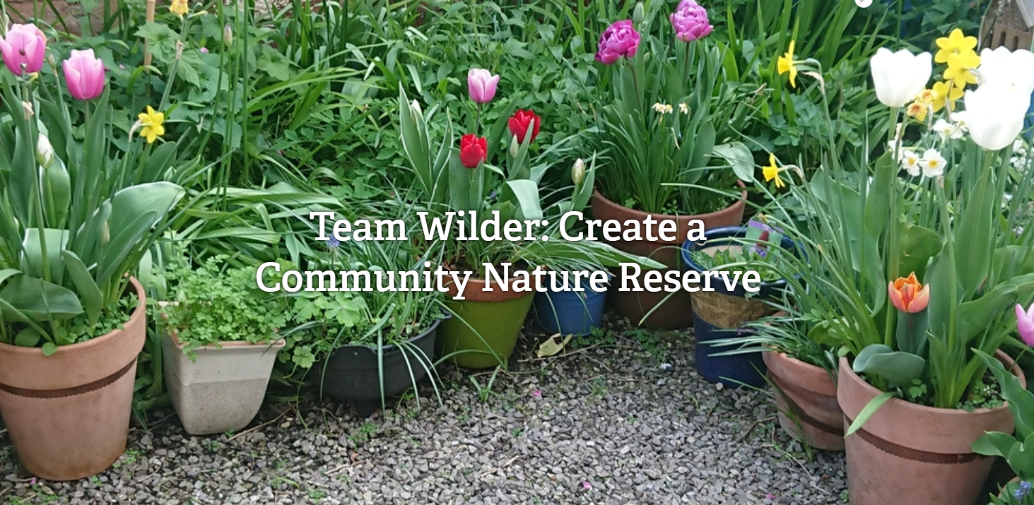
Community nature reserves
An area of land with dense houses, gardens, semi-green species, and wilder places
Get the community involved to help join up the green spaces: all small actions for nature collectivity make a big difference
Community nature reserve
Notes:
Community nature reserves are created when you take an area of land with dense housing, semi-green spaces and wilder spaces and get the community involved in enhancing these species for wildlife and join up these green space. The whole community can get involved and all small actions make a huge difference.

Slide 4
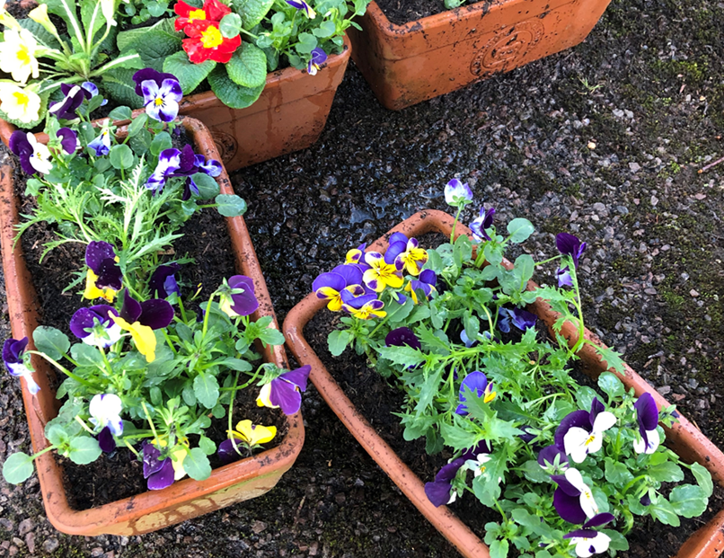
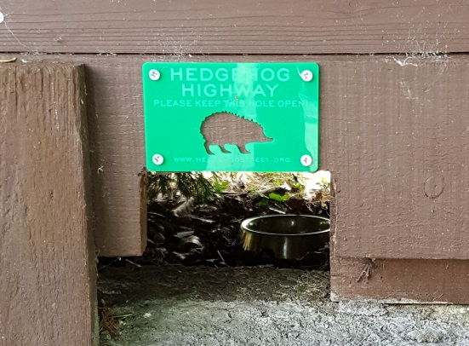
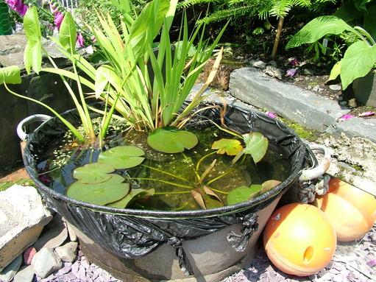
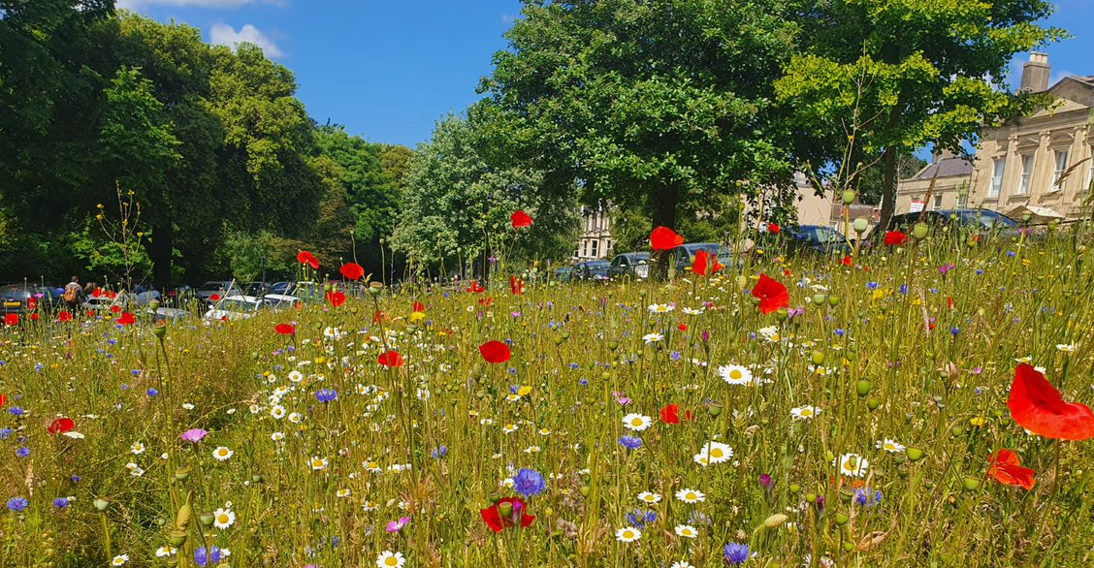
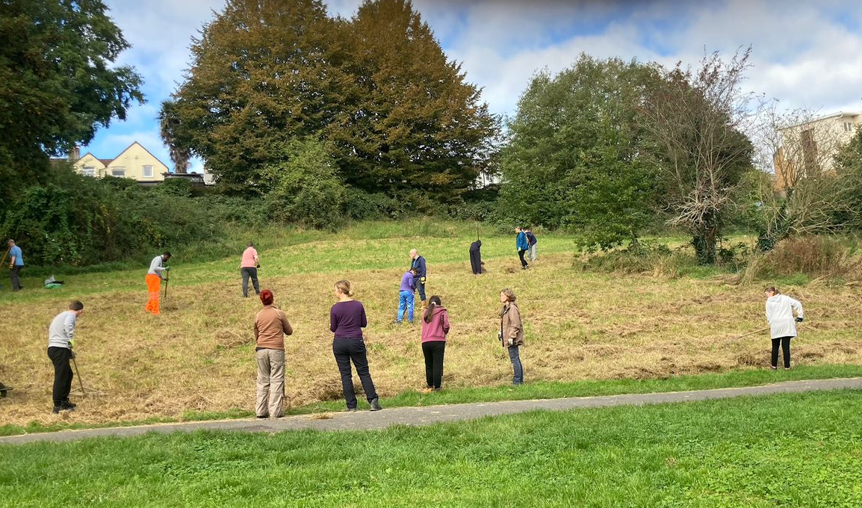
Image: Hedgehog Street
Image: Anna Williams
Credit: West Bristol Climate Action
Ways the community can help
Credit: Manor Woods Valley
Notes:
Actions can be taken anywhere – to act as corridors and stepping stones
Front and back gardens – e.g. flower pots, hedgerows along garden boundaries, log piles, ponds and mini ponds, mini meadows
Allotments – wildlife friendly food growing
Open/public spaces – such as managing green spaces for the council, ensuring that they are managed for wildlife and people
Share wildlife sightings and engage others around you to do the same!

Slide 5
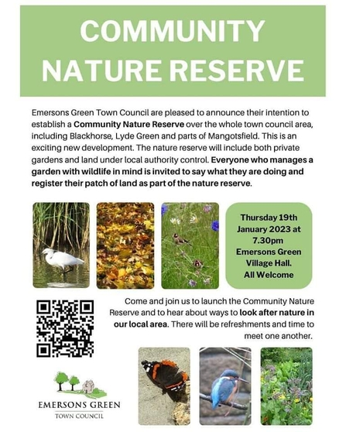
Examples
BS3 Greater Bedminster Urban Nature Reserve (Ben Barker)– wildlife friendly features and wildlife recordings.
Emersons Green Community Nature Reserve – includes gardens. Those taking action can register their patch as part of the nature reserve.
Hartcliffe and Withywood (Luke Cooper)– joining up parks, green spaces, allotments, nature reserves and Dundry footpaths.
Image: Emersons Green Town Council
Notes:
A number of urban nature reserves have been created around Bristol. There are quite a few examples on the Team Wilder Website.

Slide 6
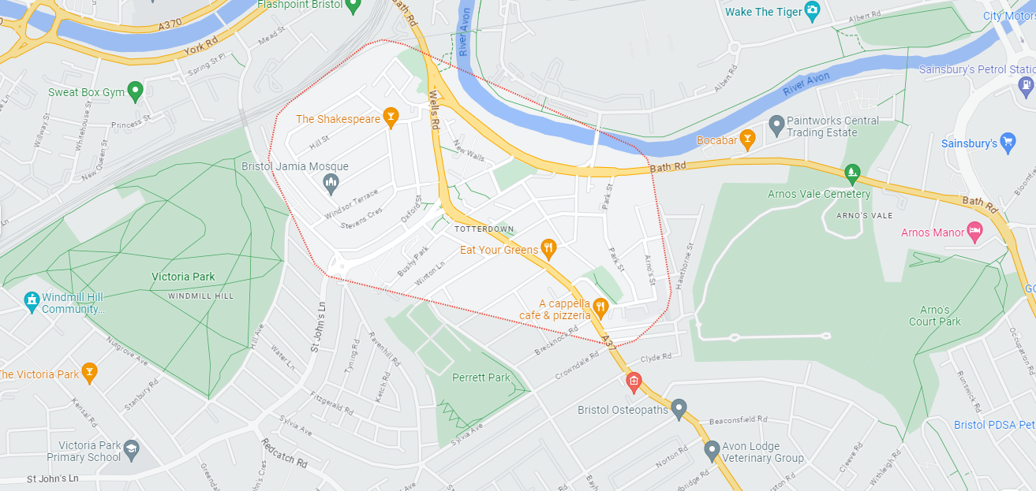
Potential for Totterdown
Image: Google Maps
Notes:
I visited Zone A in Totterdown a few months ago to help advise on the habitat creation and enhancement on site. The site has enormous potential and can really help to act as an extra stepping stone in the network. It can help to link gardens and other community spaces such as that just down the hill from Zone A on Park Street.
Arnos Vale is also to the east and Victoria Park is to the west, so the enhancement of the gardens and spaces between these larger urban green spaces would act as an amazing corridor and improve connectivity.

Slide 7
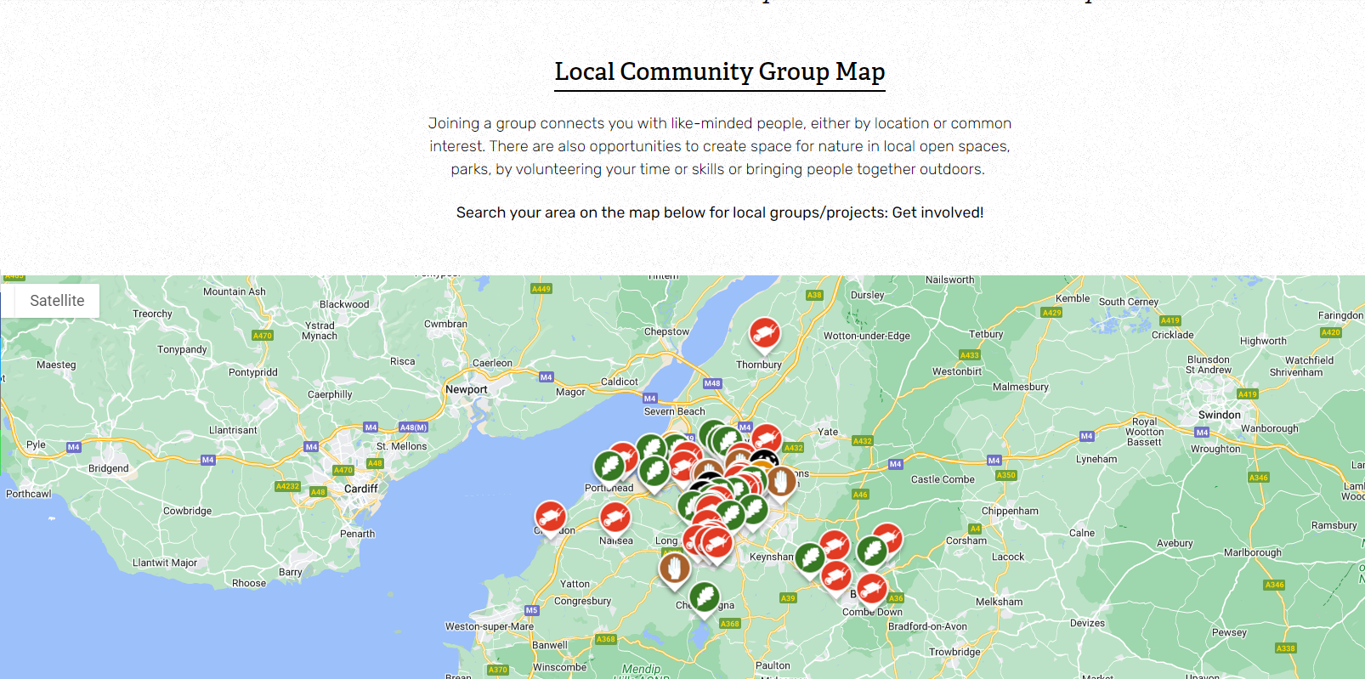
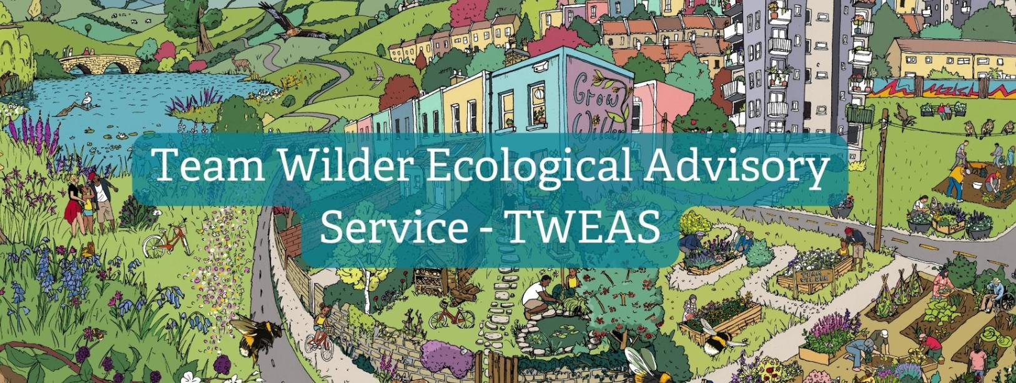
Support from Team Wilder
Notes:
The team wilder website have lots of resources to help you – it has ways to set up a community nature reserve, examples and case studies and advice on how to make habitat features in your garden or community.
There is also a local community group map on there where communities can map what they have done so that it is visible for others in the area to see. This can highlight corridors in the landscape.
The Team Wilder Ecological Advisory Service is also available – as I said I advise communities and individuals on ways to improve their community land or garden. I will also be providing workshops and these can be dependent upon the demand of the community. E.g. I am planning to deliver a pond creation workshop to emersons green as there are currently only a few people that are creating ponds in that area so need some support.

Slide 8
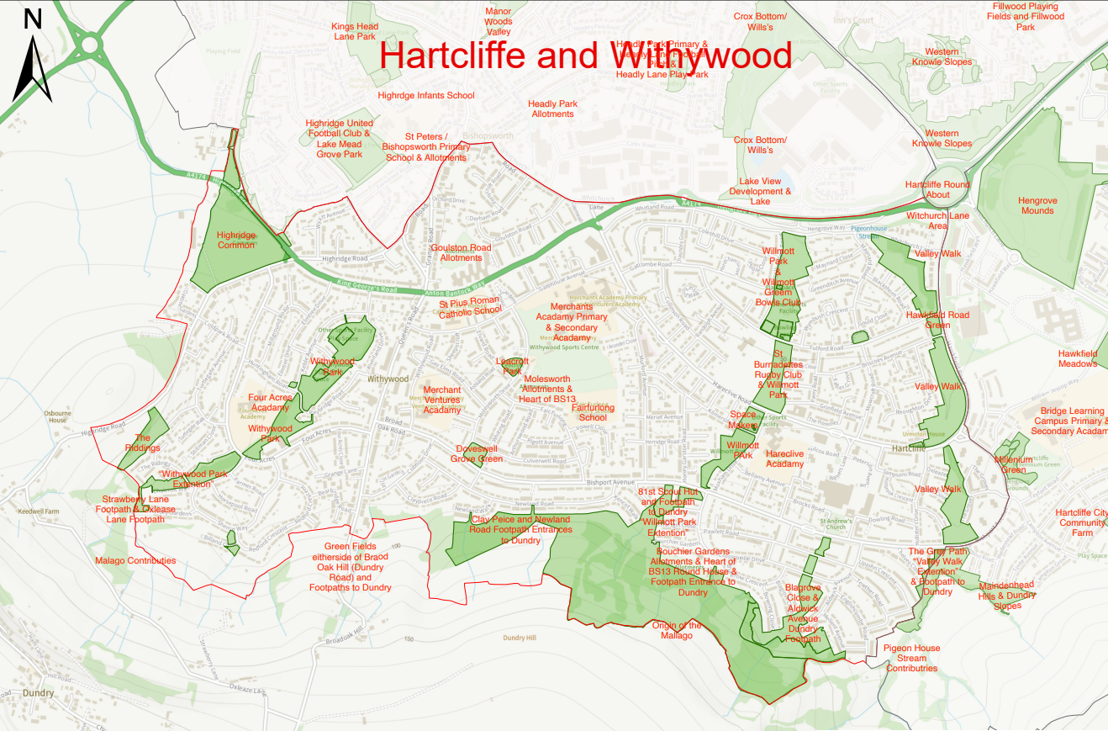

Slide 9
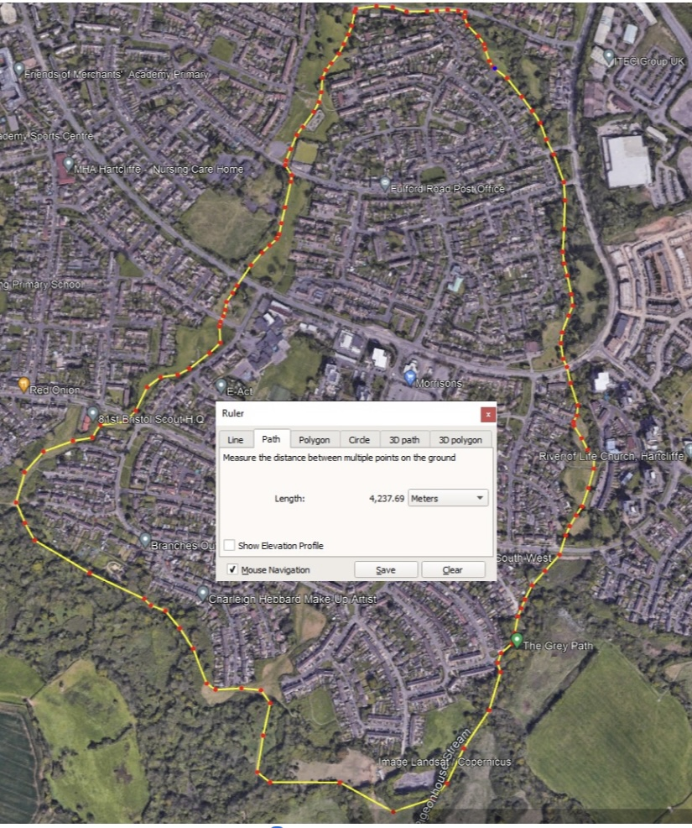

Slide 10
Thank you!

