Slide 1

TRESA Annual General Meeting
ArtPark, Wells Road,
7.30pm Tuesday 14th November 2023

Slide 2
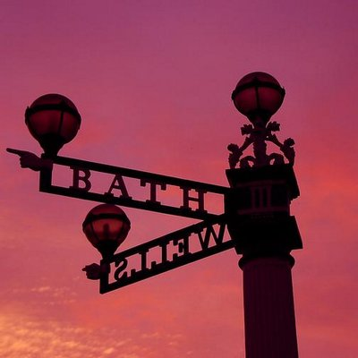
Order of the meeting
Welcome and introductions
Annual Report 2022/2023
Treasurer’s Report
Election of Directors for 2023/2024
Comfort break and raffle
Museum of Totterdown, John O’Donnell
Looking to the future: concerns, ideas and activities (informal discussion)

Slide 3
Attendance: Suzanne Audrey, Anne Silber, Simon Hobeck, Miranda Walker, Nick Walters and 11 members of the public
Apologies: Robin Millard, Carolyn Jones
The AGM business was completed:
- the Annual Report was delivered (see following slides)
- the Treasurer’s report was accepted
The following directors were re-elected:
Suzanne Audrey, Chair
Anne Silber, Vice-Chair
Robin Millard, Company Secretary
Simon Hobeck, Treasurer
Carolyn Jones
Miranda Walker
Nick Walters

Slide 4

Annual Report, Suzanne Audrey, Chair
This year TRESA held public meetings on a range of issues:
CHEESE: Cold Homes Energy Efficiency Survey Experts
Temple Quarter Regeneration
Bristol Waste
Proposals for developments surrounding Bristol
Totterdown unicorn foal
Urban Nature Reserves and wildlife corridors
TRESA has remained active on behalf of the local community:
Commenting on planning applications e.g. Mead Street (former Bart Spices site)
St Lukes Road crossing
Contributing to local consultations e.g. Mead Street development brief, Whitehouse Street, Temple Quarter, Temple Island

Slide 5
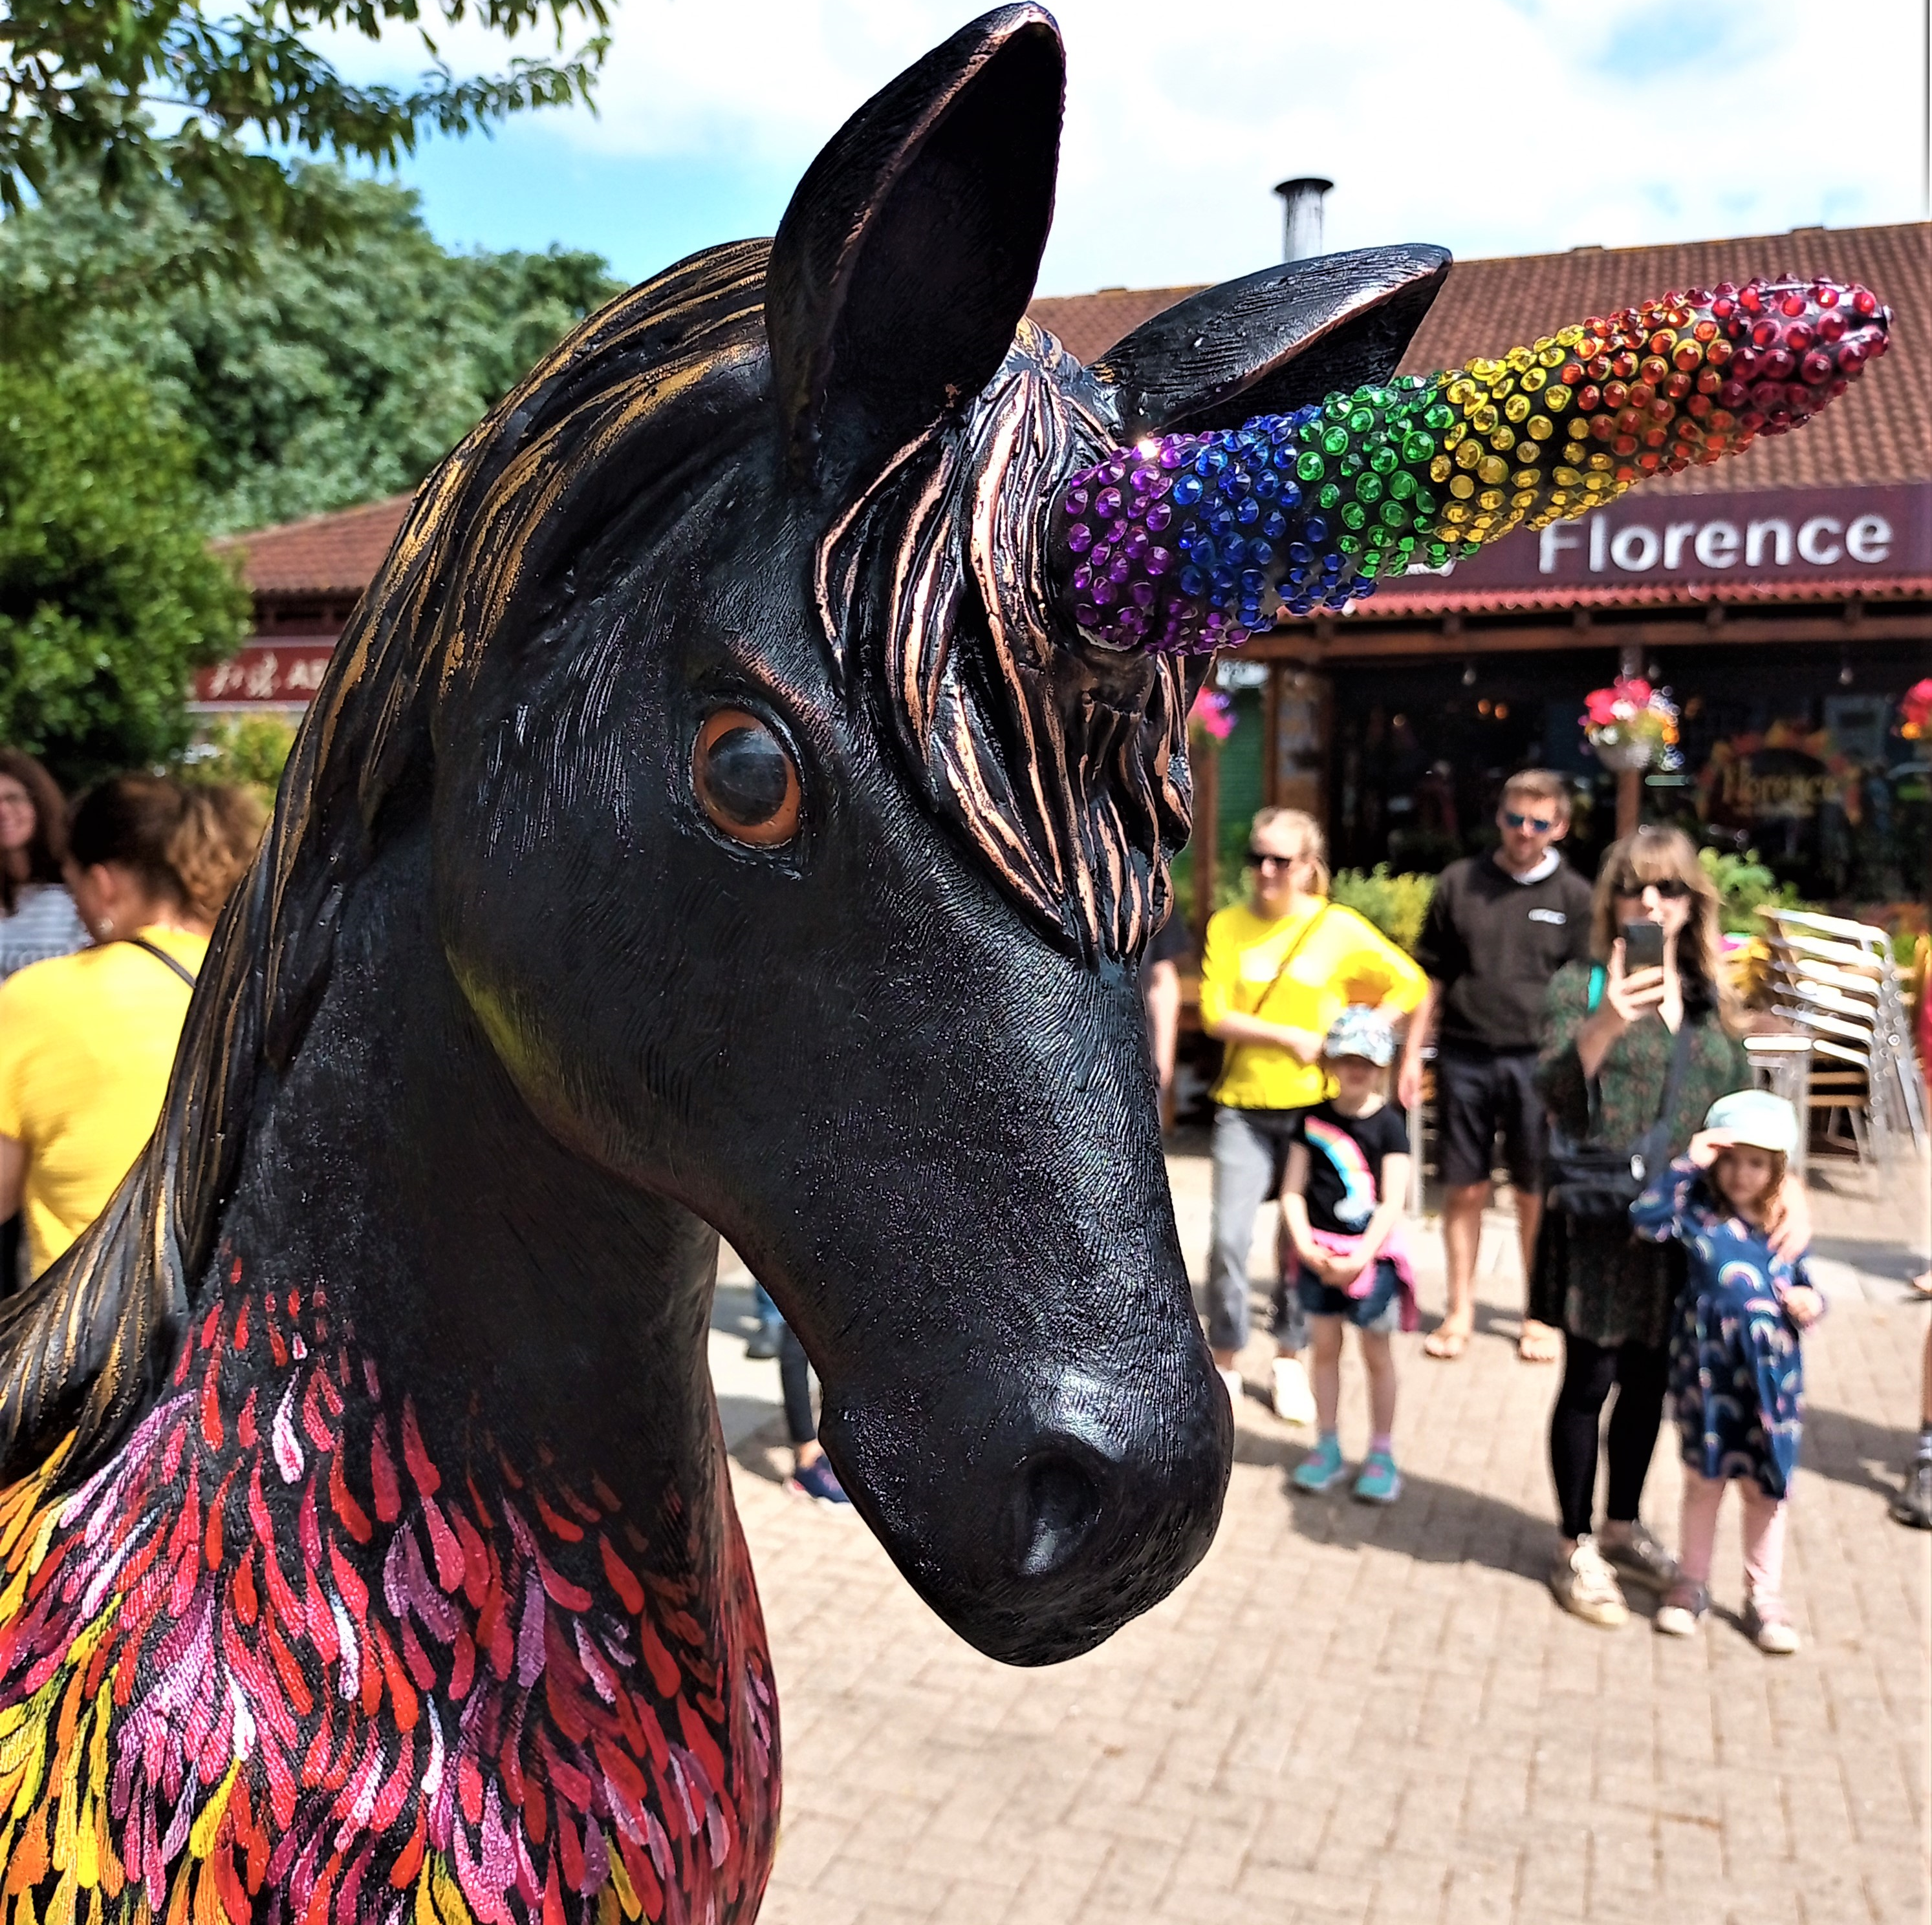
Community events and activities
Front Garden Awards
Totterdown Wombling litterpick (BrisWalkfest)
Unicorn naming ceremony
BS3 consultation stall with Action Greater Bedminster
Totterdown mosaic introductory workshop

Slide 6
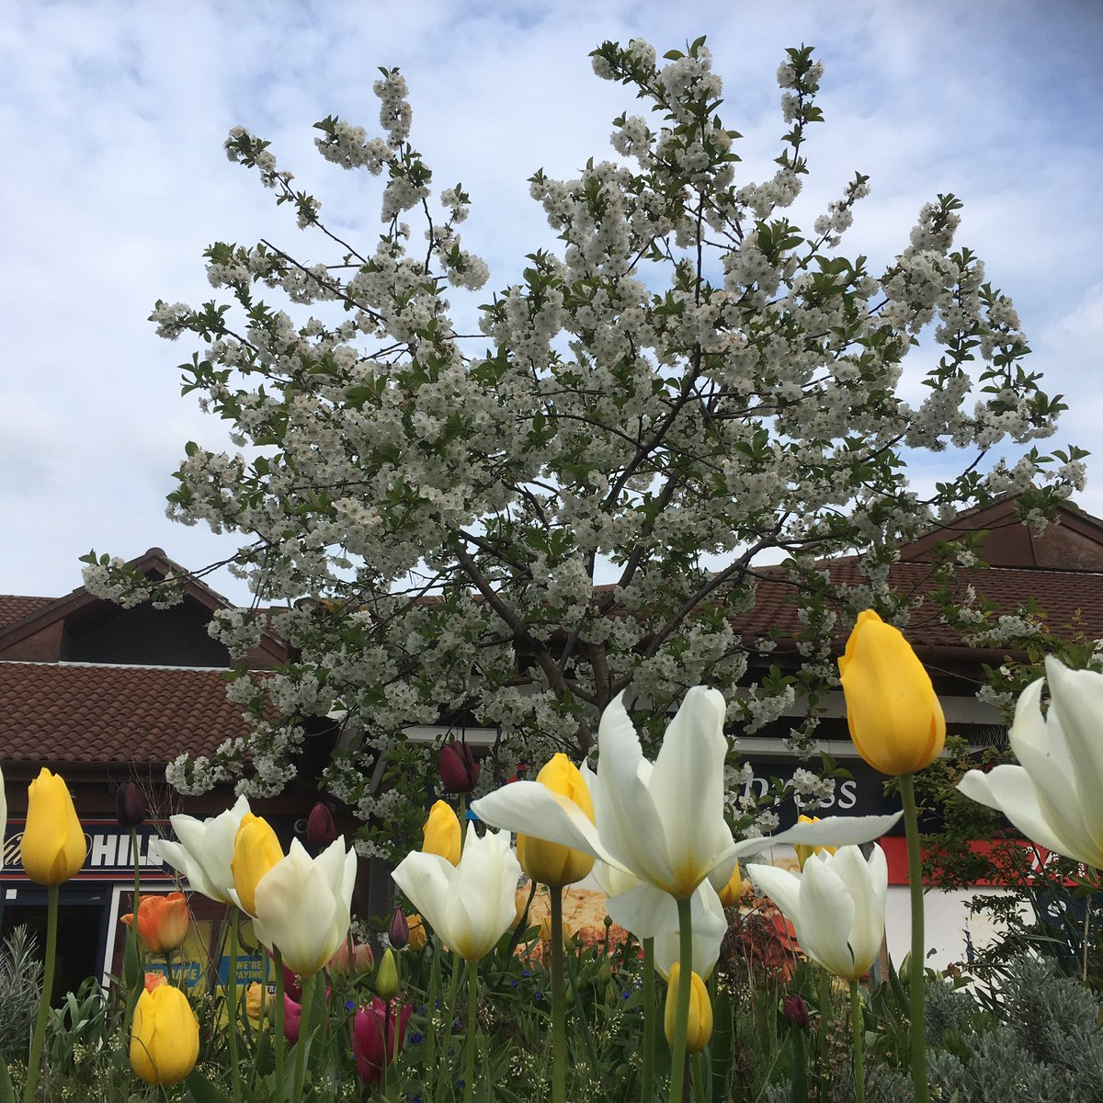
Membership Secretary & Vice-Chair, Anne Silber
TRESA membership fees continued at £3 a year for Totterdown residents, £2 for ‘friends’
Membership has remained steady, with currently 125 paid-up members and friends
Totterdown Sprouting
The gardening group maintain the planters outside Tesco in Totterdown Square
Meets monthly 2nd Monday of month
Well attended and works as a social group as well as a gardening group
Tulip, allium and crocus bulbs planted for spring display
In August the group did some maintenance work on the beds outside Bushy Park flats at the request of a TRESA member

Slide 7
Community Orchard
Wassail took place in January
Took part in the Get Growing trail in June [thanks to WhatsApp group members, Shabba and Nu]
Apple pressing in October [thanks to Richard Jones for his support for this event]
Wassail and a pruning event are planned for January 2024
WhatsApp group for events and maintenance but more support needed for work parties
The Good Gym offered to help with clearing bindweed on a Tuesday evening, but it would not be possible to do this work in the dark
Street planters
Planter on Firfield street has been taken over by TACA for Zone A
Stanley Hill planter is maintained by a local resident
Angers Road planter languishes but does have daffodil bulbs
Other street planters have been moved to the community space [mostly for herb growing] and the front area of Knowle Constitutional club

Slide 8
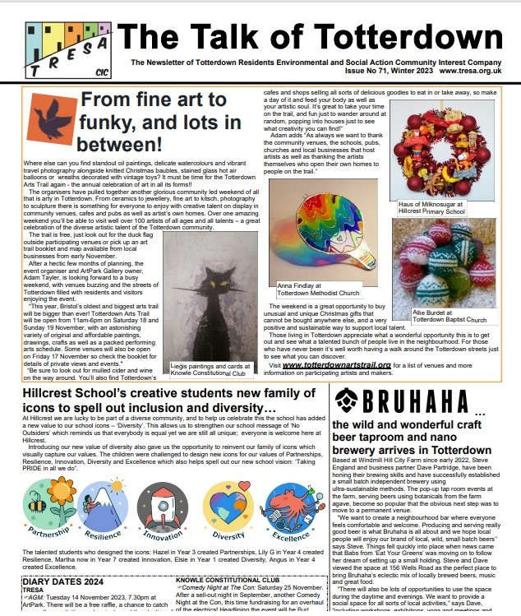
Talk of Totterdown, Carolyn Jones, Editor
Published quarterly and printed locally by Doveton Press
Hand delivered by volunteers to all Totterdown homes and businesses
Also available via the TRESA website and Facebook
Print costs supplemented through TRESA membership fees and advertising revenue
Updates on activities in Totterdown, planning, local businesses, weather, local history, living sustainability, gardening, news from our local councillors
Younger voices represented by the Press Pack at Hillcrest School
Thank you to the contributors, advertisers, deliverers and our readers for supporting the publication

Slide 9

Treasurer’s Report, Simon Hobeck
Company accounts have been prepared ready for approval at TRESA's 2023 Annual General Meeting and submission to Companies House
TRESA has continued to bank with The Co-operative Bank and to use an online tracking of all income & expenditure to ensure clear financial administration
Balance as of 31 May 2023 was £11,033.74
Key expenditure within the year included: printing 1,090.00; Totterdown Traders quiz £300.00; insurance £262.16

Slide 10

The following people are standing for election:
Carolyn Jones (Director)
Simon Hobeck (Treasurer)
Anne Silber (Vice-Chair)
Miranda Walker
Suzanne Audrey (Chair)
Nick Walter
Robin Millard (Company Secretary)

Slide 11

Comfort break and drinks
Raffle!

Slide 12
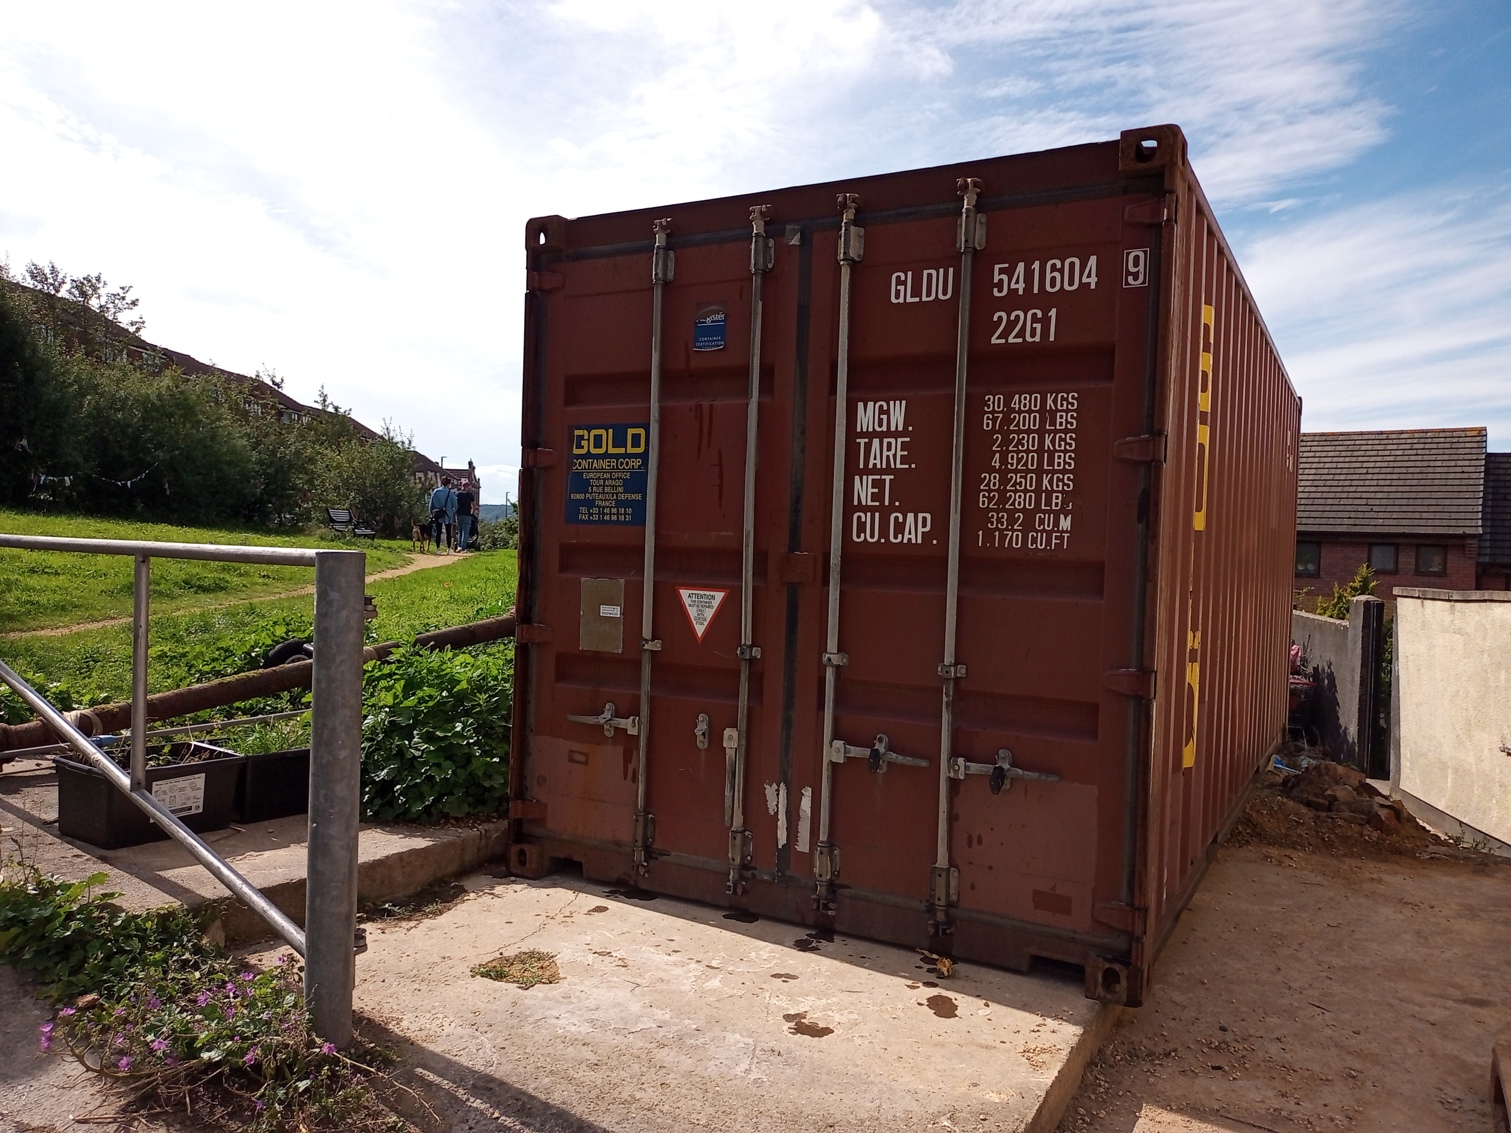
Totterdown museum
John O’Connell

Slide 13

Looking to the future…
News, concerns, ideas and activities (informal discussion)
- Totterdown Arts Trail 18-19 November
- Totterdown Nature Reserve mapping is being supported by a group of UWE students

